Slide 1
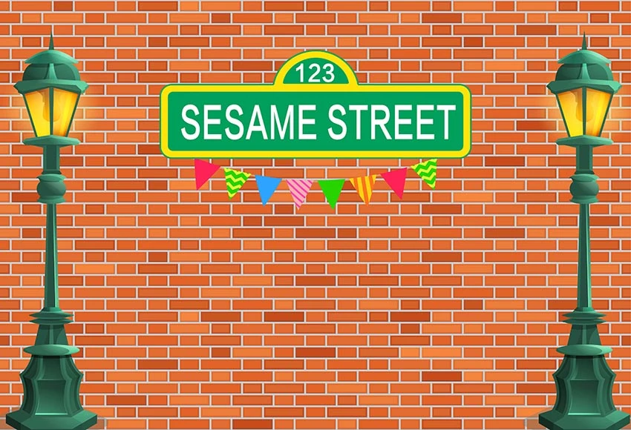


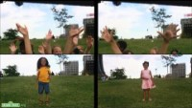

Block Party!
Saturday
Neighbors List
Charlie Dey
Marcus Golden
Andy Qui Le
VOTE
Nove
Your voice matters!
Faiz Ikramulla
Lena DS
Parker Broadnax
Ayomide Okuleye

Slide 2

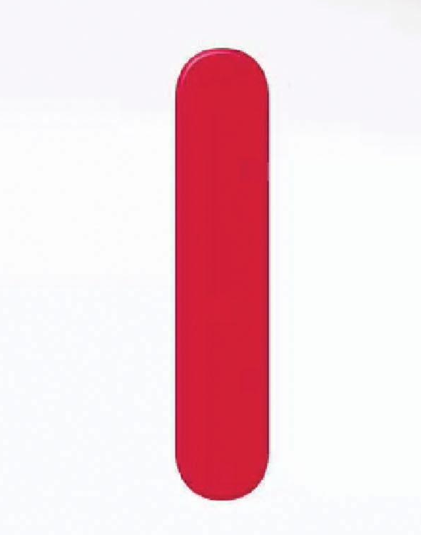
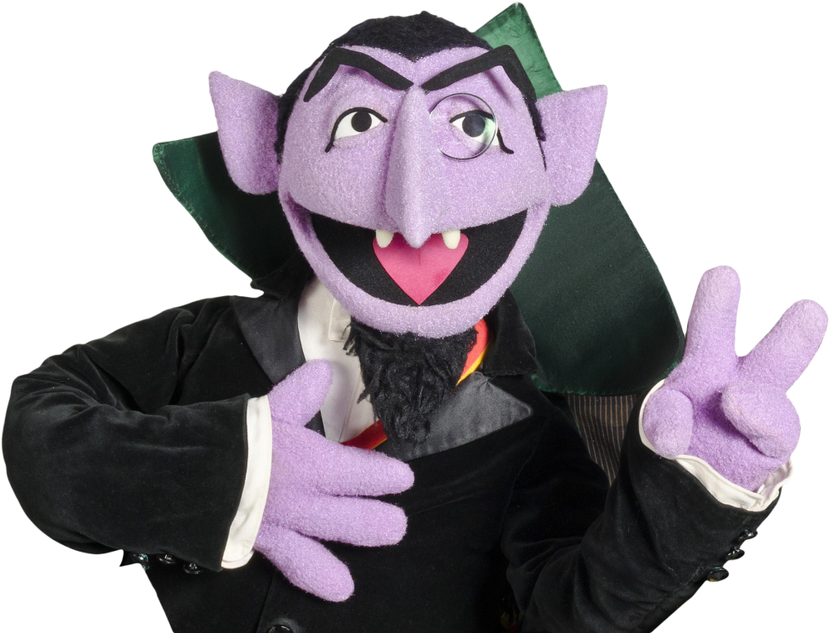
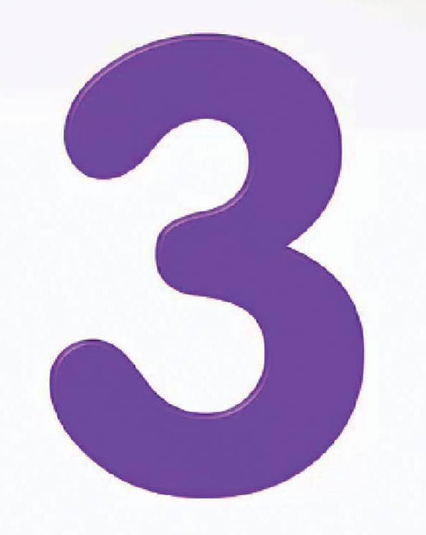
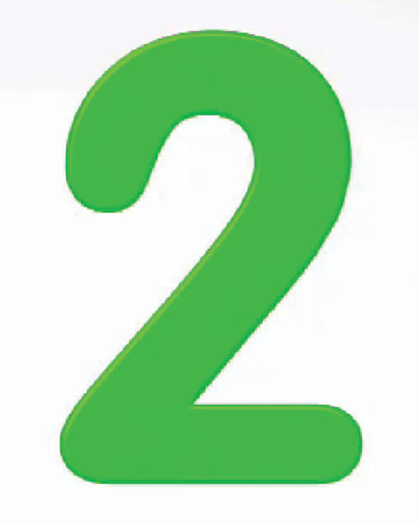

Sesame Street Neighbor’s Tasks
1 2 3
Goal: An evaluation tool to assess for fair voter districting
1. Starting prototype of the voter simulation
2. Acquire data sets to work with
3. Project plan mapped out

Slide 3
Sesame Street Neighbor’s Tasks
1 2 3
Goal: An evaluation tool to assess for fair voter districting
1. Finishing prototype of the voter simulation
2. Clean our data sets
3. Project plan revised mapped out (3rd time)

Slide 4
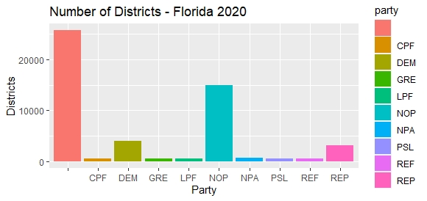
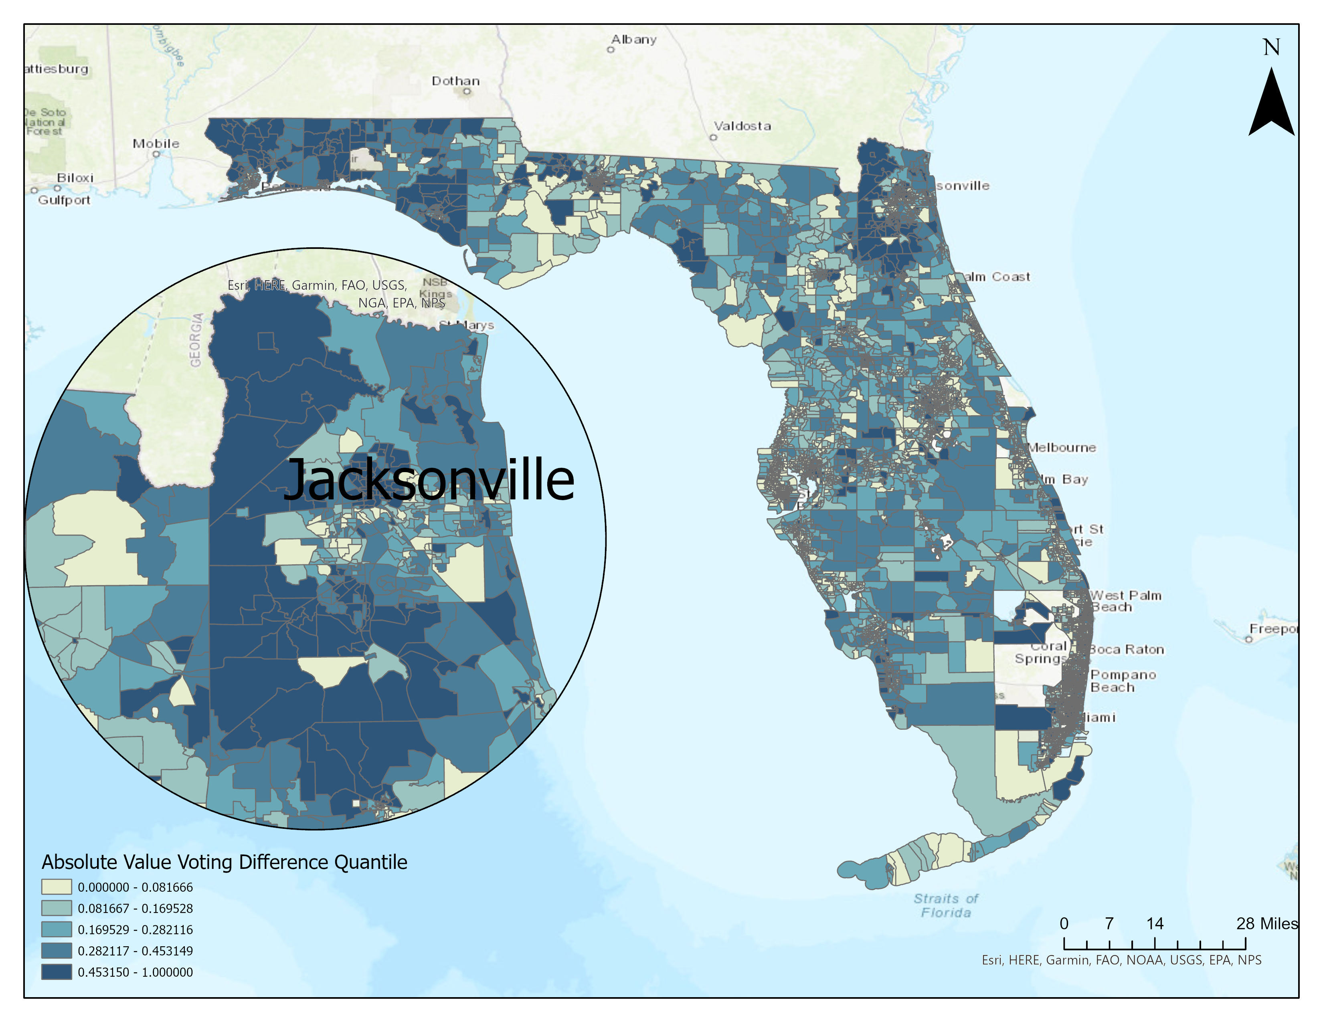
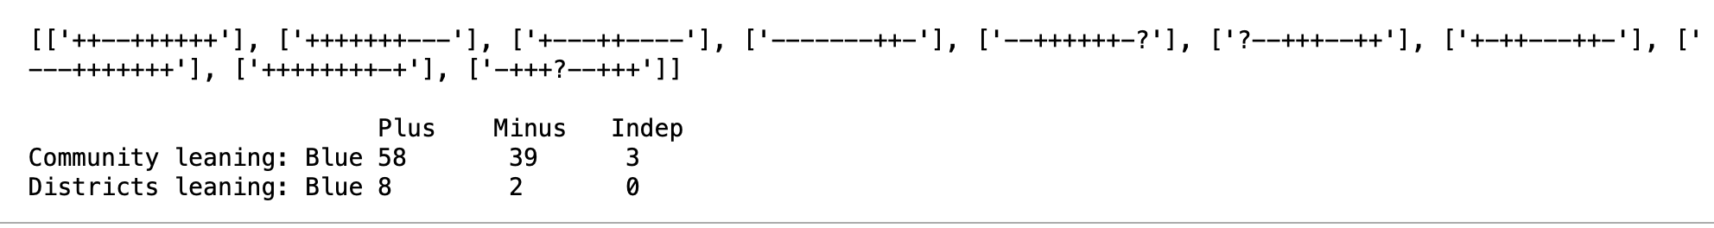
Sesame Street Neighbor’s Tasks
1 2 3
Visualization 2

Slide 5
Sesame Street Neighbor’s Tasks
1 2 3
Goal: An evaluation tool to assess for fair voter districting
1. Developing voter simulation code – converting 1D to 2D
2. Structuring our data sets – format conversions/analysis
3. Alt. districting solution planning in progress – apply to #1 and #2

